Slide 1
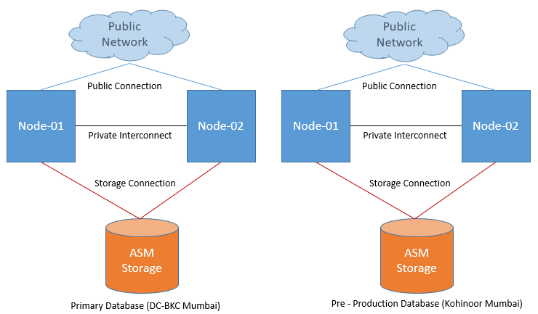
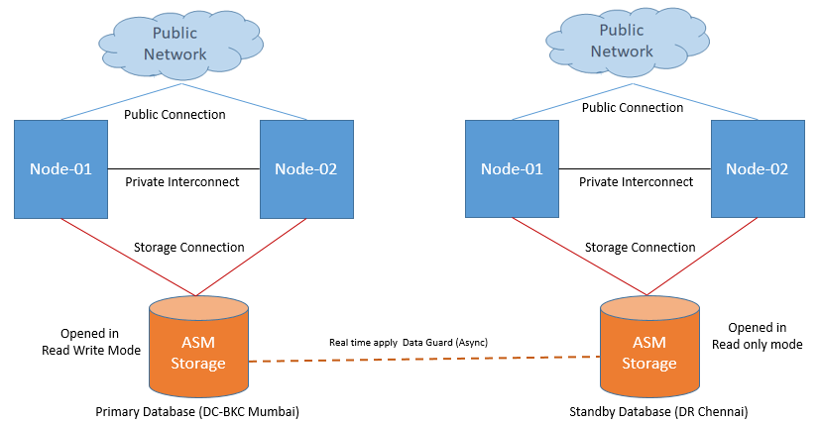
Database architecture (Production, Pre Production and Disaster Recovery)
Standby database will be configured in Maximum Availability Mode. This protection mode provides the highest level of data protection that is possible without compromising the availability of a primary database. Transactions do not commit until all redo data needed to recover those transactions has been written to the online redo log and to at least one synchronized standby database. If the primary database cannot write its redo stream to at least one synchronized standby database, it operates as if it were in maximum performance mode to preserve primary database availability until it is again able to write its redo stream to a synchronized standby database.

Slide 2
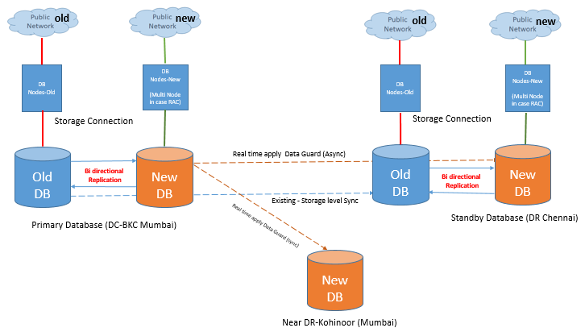
Database Architecture (Holistic)
Considering Old DB is available at DR Chennai and already DR solution is configured between old DB at DC Mumbai and old DB at DR Chennai using storage replication

Slide 3
RPO and RTO at Database Layer
Objective | Description
RPO (DB Layer) | Zero (near zero) RPO will be achieve through real time apply Maximum Availability Mode Configuration with certain assumption and limitation Assumption : Zero latency network will be used to transfer redo from DC-BKC to DR-Chennai Limitation: This mode ensures that no data loss will occur if the primary database fails, but only if a second fault does not prevent a complete set of redo data from being sent from the primary database to standby database. (In case first standby goes down and after few minutes primary will get crashed then there might be chance of data loss)
RTO (DB Layer) | 15 Min RTO will be achieve using Active Data Guard Configuration Assumption : For graceful switchover to DR-Chennai Standby database is in sync and zero lag observed No active application connections available at primary site Batch jobs, backups and monitoring disabled and no active connections available at primary site For activating standby site in case primary crash. Activating standby database is on decision base DR- Chennai will be activated and data will be available until last received redo available and applied.

Slide 4
Assumption - Database
Assumption
Oracle database 19c will be used as RDBMS other flavours of databases will be out of scope. (e.g. mongo dB etc.) Compatibility will be approved by respective vendor support between Oracle database Version, OS version, VMware Version and Storage Version for Oracle RAC and ASM Configuration. Production database will deployed at DC-BKC Mumbai. DR databases will be deployed at DR-Chennai In case near DR or Far sync site, It will be deployed at Kohinoor Mumbai. Development/Pre production databases will be deployed at Kohinoor Mumbai and there will not be DR site configured for Dev and Pre Prod database. Zero latency network will be established between DC-Mumbai and Kohinoor Mumbai, between DC-Mumbai and DR-Chennai as well Between Kohinoor Mumbai to DR Chennai Production Database will be mirrored to all DR sites using Oracle data guard High Availability Mode real time apply method. Production database will be configured with Multi Node Real application cluster (RAC) to achieve high availability Production and DR Databases will be configured with same capacity like compute, storage and maintained same cluster level Production database and Pre Production database will be configured with similar setup (e.g.: Real Application cluster) to achieve best practices like performance test pre deployment of application modification, prior to implement dba changes like index creation, index rebuild, reorg. Table, patching, upgradation etc. Data Replication between old and new database will be handled by ETL tool and configuration should be tested thoroughly at DC Mumbai as well at DR Chennai post switchover. To differentiate and achieved realistic DC and DR Setup only one site will be functioning at a time and data will be sent to opposite site according to agreed method. Post Switchover or failover data replication between Old and New DB will be treated separately as per the ETL tool used and supported functionality (If required vendor discussion can be enabled to understand post switchover functionality.) There will be two DR sites for new DB 1) DR-Chennai (Full) and 2) Near DR – Kohinoor Mumbai (Only standby database with sync high availability mode) Database Architecture Design will be approved by customer as well as database vendor Considering Old DB is available at DR Chennai and already DR solution is configured between old DB at DC Mumbai, old DB at DR Chennai using storage replication In Case any gap in understanding during configuration which should be under consideration.

